Slide 1
Computational Physics
(Lecture 13)
PHY4061

Slide 2
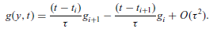
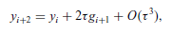
Another way to improve an algorithm is by increasing the number of mesh points j.
  Thus we can apply a better quadrature to the integral.
  For example, if we take j = 2, and then use the linear interpolation scheme to approximate g(y, t) in the integral from g_{i} and g_{i+1},

Slide 3
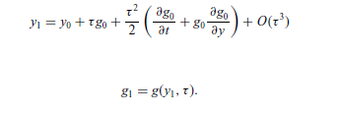
One order of magnitude better than Euler.
need the values of the first two points in order to start this algorithm.
can be obtained by the Taylor expansion around the initial point at t = 0.
Can we include more points and achieve higher accuracies?

Slide 4
we can always include more points in the integral to obtain a higher accuracy
  we will need the values of more points to start the algorithm!
  impractical if we need more than two points in order to start the algorithm.
  the errors accumulated from the approximations of the first few points will eliminate the apparently high accuracy of the algorithm!

Slide 5
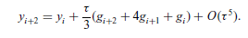
We can make the accuracy even higher by using a better quadrature.
For example, we can take j = 2 and apply the Simpson rule to the integral.
We can use this one as the corrector and the algorithm of O(τ³) as the predictor.

Slide 6
One simple model a motorcycle jump over a gap:
The air resistance on a moving object is roughly given by f_{r}=-κvv = −cAρvv, where A is cross section of the moving object, ρ is the density of the air, and c is a coefficient that accounts for all the other factors on the order
of 1.

Slide 7
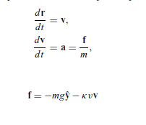

Slide 8
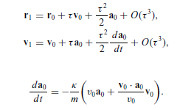
Assuming that we have the first point given, that is, r₀ and v₀ at t = 0,
the next point is then obtained from the Taylor expansions and the equation set with

Slide 9
// An example of modeling a motorcycle jump with the
// two-point predictor-corrector scheme.
import java.lang.*;
public class Jump {
static final int n = 100, j = 2;
public static void main(String argv[]) {
double x[] = new double[n+1];
double y[] = new double[n+1];
double vx[] = new double[n+1];
double vy[] = new double[n+1];
double ax[] = new double[n+1];
double ay[] = new double[n+1];
// Assign all the constants involved
double g = 9.80;
double angle = 42.5*Math.PI/180;
double speed = 67;
double mass = 250;
double area = 0.93;
double density = 1.2;
double k = area*density/(2*mass);
double dt = 2*speed*Math.sin(angle)/(g*n);
double d = dt*dt/2;
// Assign the quantities for the first two points
x[0] = y[0] = 0;
vx[0] = speed*Math.cos(angle);
vy[0] = speed*Math.sin(angle);
double v = Math.sqrt(vx[0]*vx[0]+vy[0]*vy[0]);
ax[0] = -k*v*vx[0];
ay[0] = -g-k*v*vy[0];
double p = vx[0]*ax[0]+vy[0]*ay[0];
x[1] = x[0]+dt*vx[0]+d*ax[0];
y[1] = y[0]+dt*vy[0]+d*ay[0];
vx[1] = vx[0]+dt*ax[0]-d*k*(v*ax[0]+p*vx[0]/v);
vy[1] = vy[0]+dt*ay[0]-d*k*(v*ay[0]+p*vy[0]/v);
v = Math.sqrt(vx[1]*vx[1]+vy[1]*vy[1]);
ax[1] = -k*v*vx[1];
ay[1] = -g-k*v*vy[1];
// Calculate other position and velocity recursively
double d2 = 2*dt;
double d3 = dt/3;
for (int i=0; i<n-1; ++i) {

Slide 10
// Predict the next position and velocity
x[i+2] = x[i]+d2*vx[i+1];
y[i+2] = y[i]+d2*vy[i+1];
vx[i+2] = vx[i]+d2*ax[i+1];
vy[i+2] = vy[i]+d2*ay[i+1];
v = Math.sqrt(vx[i+2]*vx[i+2]+vy[i+2]*vy[i+2]);
ax[i+2] = -k*v*vx[i+2];
ay[i+2] = -g-k*v*vy[i+2];
// Correct the new position and velocity
x[i+2] = x[i]+d3*(vx[i+2]+4*vx[i+1]+vx[i]);
y[i+2] = y[i]+d3*(vy[i+2]+4*vy[i+1]+vy[i]);
vx[i+2] = vx[i]+d3*(ax[i+2]+4*ax[i+1]+ax[i]);
vy[i+2] = vy[i]+d3*(ay[i+2]+4*ay[i+1]+ay[i]);
}
// Output the result in every j time steps
for (int i=0; i<=n; i+=j)
System.out.println(x[i] +" " + y[i]);
}
}
we have used the cross section A = 0.93 m^2, the takingoff speed v0 = 67 m/s, the air density = 1.2 kg/m^3, the combined mass of the
motorcycle and the person 250 kg, and the coefficient c = 1.

Slide 11
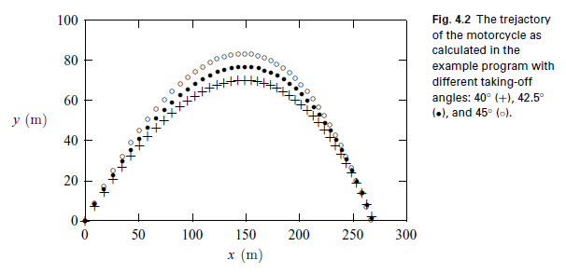

Slide 12
The Runge–Kutta method
A more practical method that requires only the first point in order to start or to improve the algorithm is the Runge–Kutta method, which is derived from two different Taylor expansions of the dynamical variables and their derivatives.
For details, please read the textbook.

Slide 13
Boundary-value and eigenvalue problems
A typical boundary-value problem in physics is usually given as a second-order differential equation
  u’’ = f( u, u’, x)
  where u is a function of x, u’ and u’’ are the first-order and second-order derivatives of u with respect to x, and f (u, u’; x) is a function of u, u’, and x.
  Either u or u’ is given at each boundary point.

Slide 14
we can always choose a coordinate system
  so that the boundaries of the system are at x = 0 and x = 1 without losing any generality
  if the system is finite.
  For example, if the actual boundaries are at x = x1 and x = x2 for a given problem, we can always bring them back to x’ = 0, and x = 1 with a transformation of x’=(x-x1)/(x2-x1)
  What if the system is infinite?

Slide 15
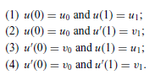
For problems in one dimension, we can have a total of four possible types of boundary conditions:
Do they look familiar to you?

Slide 16
more difficult to solve than the similar initial-value problem.
  for the boundary-value problem, we know only u(0) or u’(0), which is not sufficient to start an algorithm for the initial-value problem without some further work.
Typical Eigen value problems are more difficult:
  Have to handle one more parameter in the equation.
  the eigenvalue λ can have only some selected values in order to yield acceptable solutions of the equation under the given boundary conditions.

Slide 17
The longitudinal vibrations along an elastic rod as an example:
  u’’(x) = −k² u(x),
  where u(x) is the displacement from equilibrium at x and the allowed values of k² are the eigenvalues of the problem.
  The wavevector k in the equation is related to the phase speed c of the wave along the rod and the allowed angular frequency ω by the dispersion relation: ω = ck.

Slide 18
If both ends (x = 0 and x = 1) of the rod are fixed,
  the boundary conditions are u(0) = u(1) = 0.
If one end (x = 0) is fixed and the other end (x = 1) is free,
  the boundary conditions are then u(0) = 0 and u’(1) = 0.

Slide 19
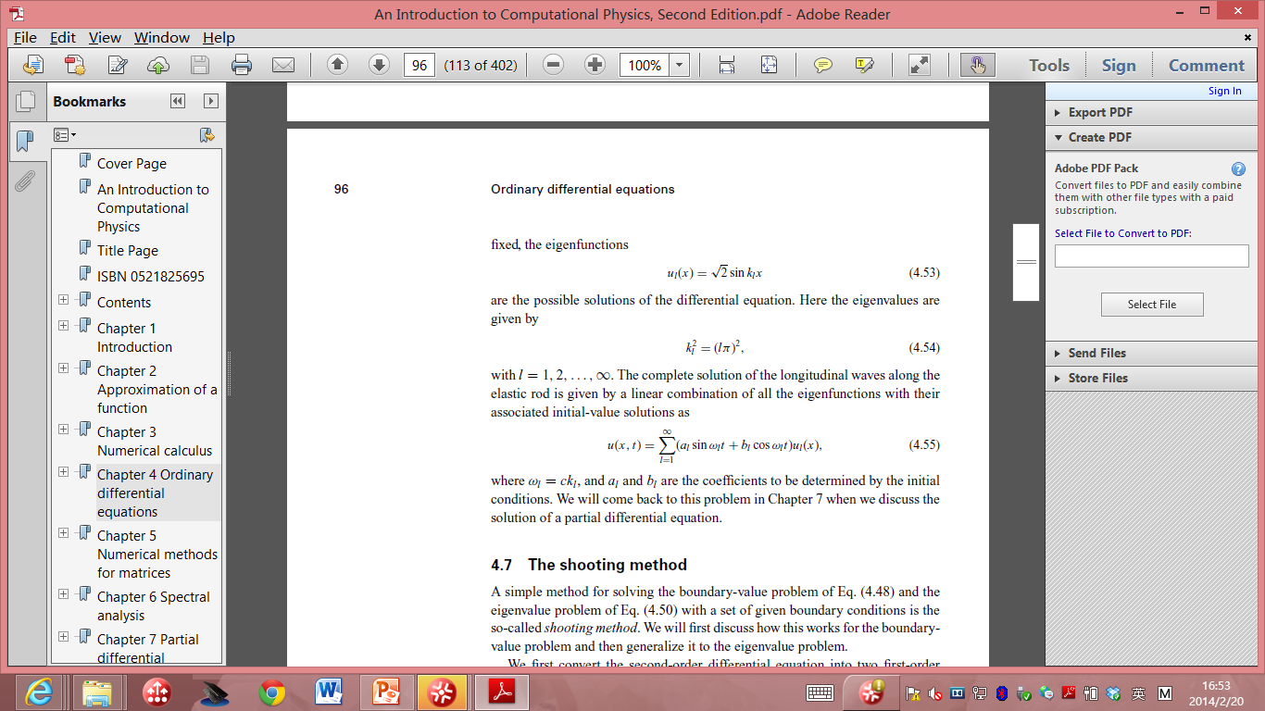
if both ends of the rod are fixed, the eigenfunctions:
the eigenvalues are :
K²_{l}= (lπ) ², l are positive integers.

Slide 20

The complete solution of the longitudinal waves along the elastic rod is given by a linear combination of all the eigenfunctions with their associated initial-value solutions as:
where ω_{l} = ck_{l} , and a_{l} and b_{l} are the coefficients to be determined by the initial conditions.

Slide 21
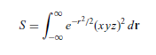
Project B
Send me a brief report (including code) and prepare a 5 min presentation.
Choose one of the following options: (each topic can be chosen by one or two students. First come, first serve.) You are highly encouraged to choose your own topic, which need my approval.
1 Write a 2D Ising model code and update each lattice site. Calculate the total energy as a function of your simulation steps and the possible critical temperature, plot your configuration, show the details of your simulations in your presentation. You can self define some parameters with reasonable physical justifications. (10% Bonus will be given if you try some block updating scheme we discussed in the class, still the maximum is capped at 100%)
2 Write a surface diffusion code to study nucleation problems on a 2D square lattice. You can define the parameters of vibrational frequencies, diffusion barriers (D) and deposition rate (R). Assume when the atoms meet each other, they will stay on the lattice site to form islands. From your simulation results, show that the number density of islands is proportional to (R/D)^{1/3} in your presentation.
3 Finish the following two problems: a) Calculate the integral with the Metropolis algorithm and compare the Monte Carlo result with the
exact result.
(b) Search on line to find algorithms and revise them to plot beautiful fractal shapes (smoke, fire …)or cartoons with random sampling approaches.
Find your own interested problems and perform Monte Carlo simulations. Need to get my approval.
Presentation will be scheduled in the last class. Please let me know your choice in two weeks.

Slide 22
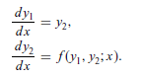
The shooting method
A simple method for boundary and eigen value problems.
First convert the second-order differential equation into two first-order differential equations
  by defining y1= u and y2= u’, assume that the boundary conditions are u(0) = u00 and u(1) = u11

Slide 23
The key is to make the problem look like an initial-value problem
  By introducing an adjustable parameter;
  the solution is then obtained by varying the parameter.
u(0) is given already, we can make a guess for the first order derivative at x = 0,
  for example, u’(0) = α.
    α is the parameter to be adjusted

Slide 24
For a specific α, we can integrate the equation to x = 1 with any of the algorithms discussed earlier for initial-value problems.
Because the initial choice of α can hardly be the actual derivative at x = 0, the value of the function u_{α}(1), resulting from the integration with u’(0) = α to x = 1, would not be the same as u1.

Slide 25
The idea of the shooting method is to use one of the root search algorithms to find the appropriate α that ensures f (α) = u_{α}(1) − u1 = 0 within a given tolerance δ.

Slide 26
An actual numerical example to illustrate the scheme.
Assume that we want to solve the differential equation
u’’ = − π² (u+1)/4
boundary conditions u(0) = 0 and u(1) = 1.
Define the new variables: y1= u and y2= u’
dy1/dx = y2,
dy2/dx= − π²(y1+ 1) / 4.

Slide 27
Now assume that this equation set has the initial values y1(0) = 0 and y2(0) = α.
Here α is a parameter to be adjusted in order to have f (α) = u_{α}(1) − 1 = 0.
We can combine the secant method for the root search and the fourth-order Runge–Kutta method for initial-value problems to solve the above equation set.

Slide 28
// An example of solving a boundary-value problem via
// the shooting method. The Runge-Kutta and secant
// methods are used for integration and root search.
import java.lang.*;
public class Shooting {
static final int n = 100, ni=10, m = 5;
static final double h = 1.0/n;
public static void main(String argv[]) {
double del = 1e-6, alpha0 = 1, dalpha = 0.01;
double y1[] = new double [n+1];
double y2[] = new double [n+1];
double y[] = new double [2];
// Search for the proper solution of the equation
y1[0] = y[0] = 0;
y2[0] = y[1] = secant(ni, del, alpha0, dalpha);
for (int i=0; i<n; ++i) {
double x = h*i;
y = rungeKutta(y, x, h);
y1[i+1] = y[0];
y2[i+1] = y[1];
}
// Output the result in every m points
for (int i=0; i<=n; i+=m)
System.out.println(y1[i]);
}
public static double secant(int n, double del,
double x, double dx) {...}
// Method to provide the function for the root search.
public static double f(double x) {

Slide 29
double y[] = new double[2];
y[0] = 0;
y[1] = x;
for (int i=0; i<n-1; ++i) {
double xi = h*i;
y = rungeKutta(y, xi, h);
}
return y[0]-1;
}
public static double[] rungeKutta(double y[],
double t, double dt) {...}
// Method to provide the generalized velocity vector.
public static double[] g(double y[], double t) {
int k = y.length;
double v[] = new double[k];
v[0] = y[1];
v[1] = -Math.PI*Math.PI*(y[0]+1)/4;
return v;
}
}

Slide 30
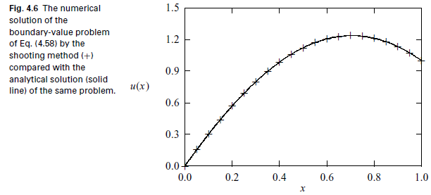

Slide 31
The boundary value problem solved in the above program can also be solved exactly with an analytical solution u(x) = cos(πx/2)+ 2 sin(πx/2)− 1.
Note that the shooting method provides a very accurate solution of the boundary-value problem.
It is also a very general method for both the boundary-value and eigenvalue problems.

Slide 32
Boundary-value problems with other types of boundary conditions can be solved in a similar manner.
  For example, if u’(0) = v0 and u(1) = u1 are given,
  we can make a guess of u(0) = α and then integrate the equation set of y1 and y2 to x = 1.
  The root to be sought is from f (α) = u_{α}(1) − u1 = 0.
  Here u_{α} (1) is the numerical result of the equation with u(0) = α.
  If u(1) = v1 is given, the equation f (α) = u_{α}’(1) − v1 = 0 is solved.

Slide 33
To apply the shooting method to an eigenvalue problem,
  the parameter to be adjusted is no longer a parameter introduced but the eigenvalue of the problem.
For example, if u(0) = u0 and u(1) = u1,
  we can integrate the equation with u’(0) = α, a small quantity.
  Then we search for the root of f (λ) = u_{λ}(1) − u1 = 0 by varying λ.
  When f (λ) = 0 is satisfied, we obtain an approximate eigenvalue λ and the corresponding eigenstate from the normalized solution of u_{λ}(x).
The introduced parameter α is not relevant here,
  because it will be automatically modified to be the first-order derivative when the solution is normalized.
  In other words, we can choose the first-order derivative at the boundary arbitrarily and it will be adjusted to an appropriate value when the solutions are made orthonormal.

